Slide 1

Winter 2023
Voting Rights Policy & The Law
Matt Barreto & Chad Dunn
Week 5
Guest lecture: Michael Rios

Slide 2
Voting Rights & Redistricting in the news
Franklin County WVRA Supreme Court
Other updates?

Slide 3
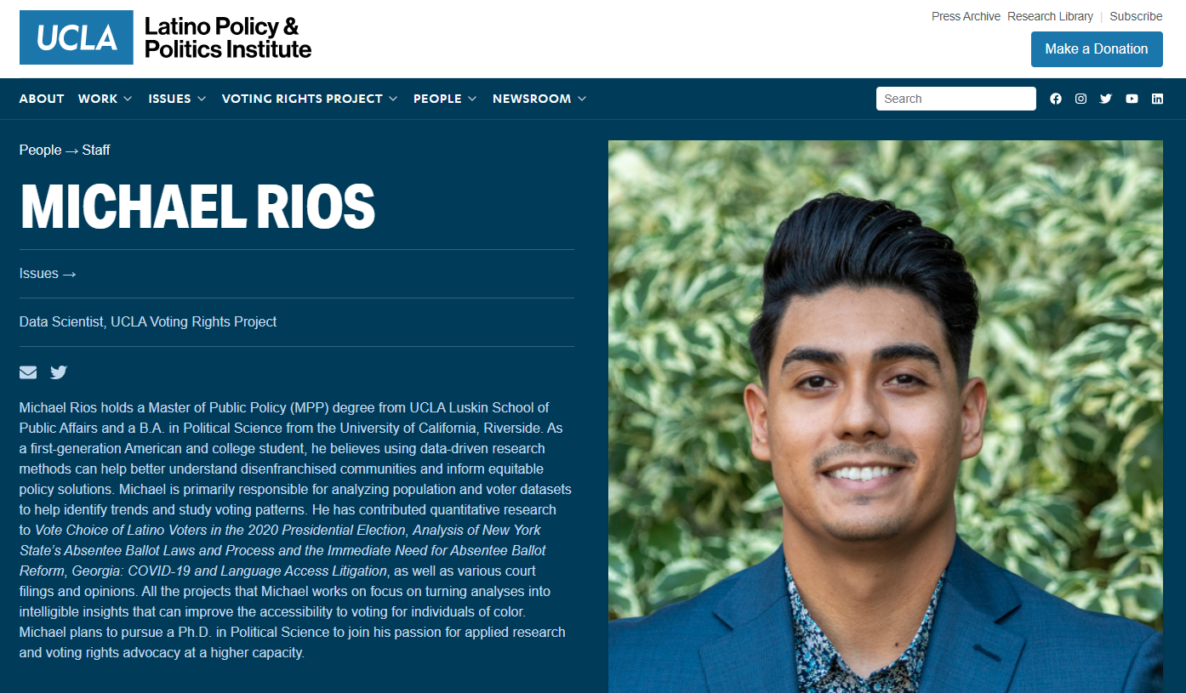

Slide 4
Defining Racially Polarized Voting
Racially polarized voting exists when voters of different racial or ethnic groups exhibit very different candidate preferences in an election.
It means simply that voters of different groups are voting in polar opposite directions, rather than in a coalition.
RPV does not mean voters are racist, it only measures the outcomes of voting patterns and determines whether patterns exist based on race/ethnicity

Slide 5
Defining Racially Polarized Voting
Bottom line: minority voters are voting one way, and non-minority voters are voting another way
But because White voters are more numerous in the at-large system, minority voters systematically lose.
The analysis is about the individual voters within a jurisdiction. It does not imply that the governing body or appointed officials are acting in a racially discriminatory fashion. Even if a governing body is well intentioned, the individual voters across the county may behave in a way that blocks minority representation.

Slide 6
Defining Racially Polarized Voting
RPV can vary in degree of intensity, and it can be easily measured and quantified using statistical analysis that has been accepted by the courts.
We now have very good data collection methods that can tell us electoral preferences precinct by precinct. And because we also have very detailed demographic data that goes precinct by precinct, we can determine with confidence how certain constituencies are voting.
Harvard Prof. Gary King has developed a technique called “Ecological Inference” which has been accepted by state and federal courts as a reliable method

Slide 7
New advancement in Ecological Inference
Detecting minority vote dilution is difficult and requires a mix of political science data, census data, statistical analysis and computer programming
One important tool in this is ecological inference (EI) to conduct analysis of voting patterns along racial lines
We developed a statistical analysis package in R, eiCompare that offers numerous new tools critical to districting
We provide a variety of tables, graphics and congruence reliability statistics to properly assess vote dilution and minority representation

Slide 8
Gathering the data
Data comes from all public databases
Election results at precinct-by-precinct level come from official county registrar of voters websites
Data on the ethnicity of voters comes from either official county records:
  In former Section 5 jurisdictions race is recorded
  In non-Section 5 areas, we use surname lists or census data
Start by looking at endogenous elections – those being challenged by the lawsuit (e.g. city council…)
Best analysis will also bring in exogenous elections

Slide 9
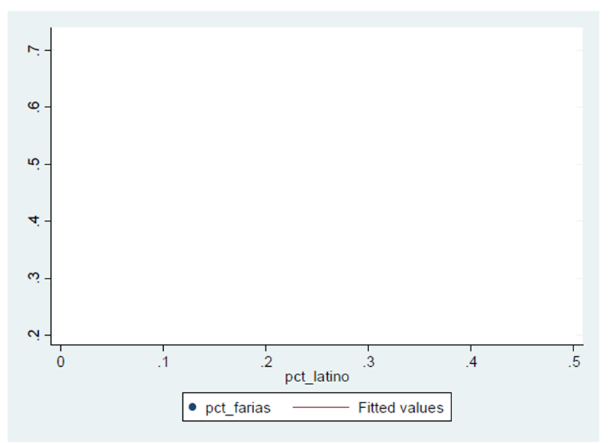
Measuring Polarized Voting
Y-axis measures percent of the vote won by the candidate in each precinct

Slide 10
Measuring Polarized Voting
Y-axis measures percent of the vote won by the candidate in each precinct
X-axis measures percent of all voters
within a precinct who are Latino

Slide 11
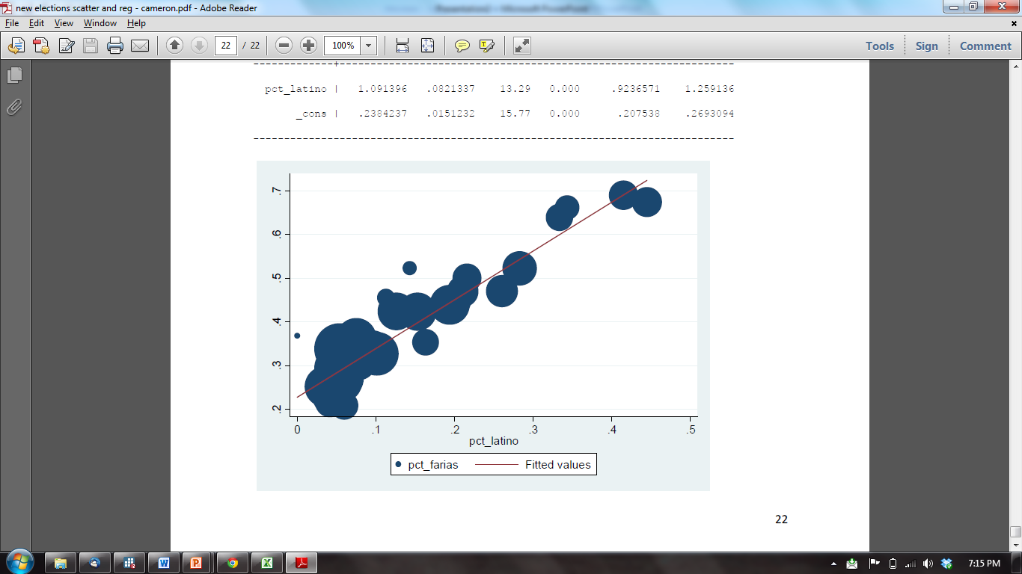
Measuring Polarized Voting
Y-axis measures percent of the vote won by the candidate in each precinct
Each dot represents the precinct result
X-axis measures percent of all voters
within a precinct who are Latino

Slide 12
Yakima County Commission 2008

Slide 13
What if there is not polarized voting?
Each dot represents a precinct

Slide 14
What does RPV look like?

Slide 15
Back to new advancements: eiCompare
Detecting minority vote dilution is difficult and requires a mix of political science data, census data, statistical analysis and computer programming
One important tool in this is ecological inference (EI) to conduct analysis of voting patterns along racial lines
We developed a statistical analysis package in R, eiCompare that offers numerous new tools critical to districting
We provide a variety of tables, graphics and congruence reliability statistics to properly assess vote dilution and minority representation

Slide 16
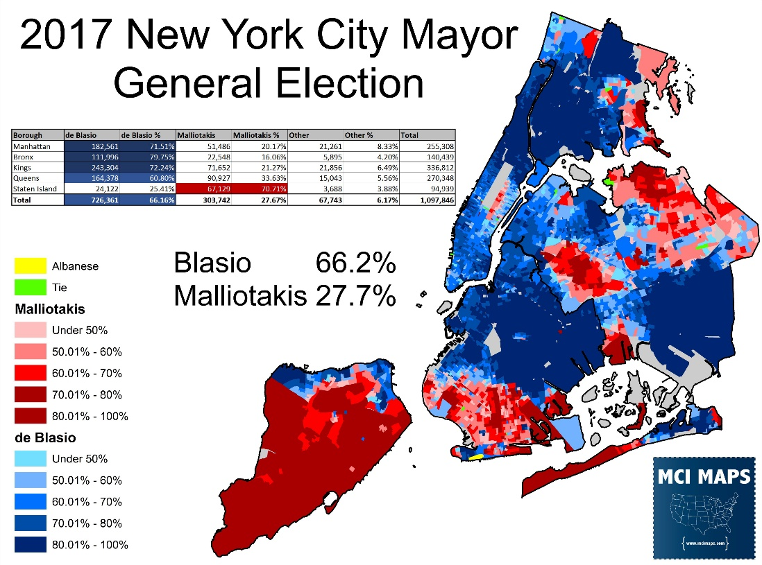
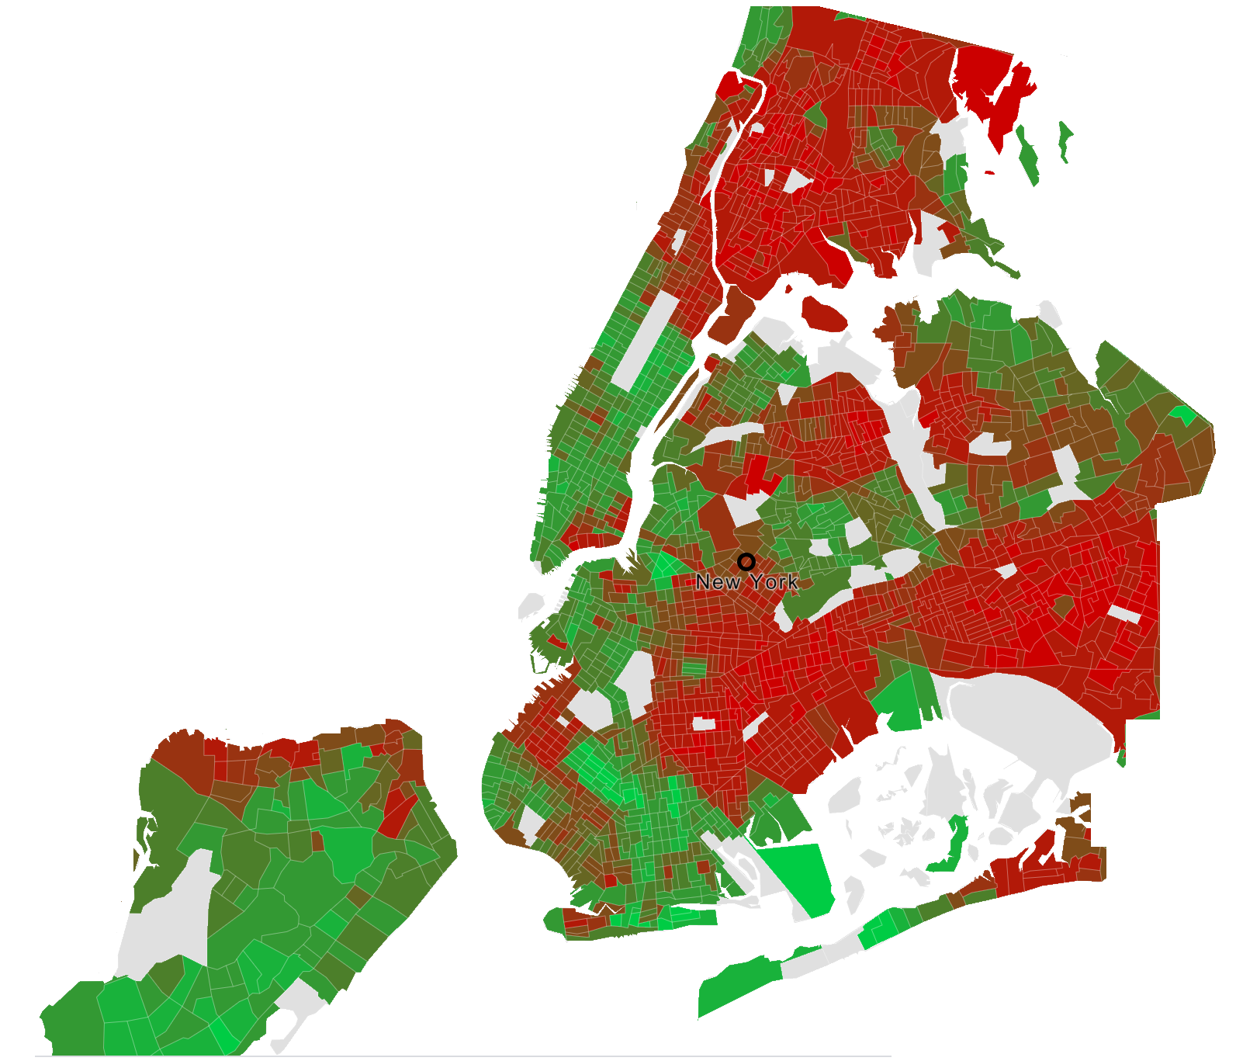
Old tools for assessing racially polarized voting

Slide 17

Using Bayesian methods for estimating race
Debates over how to properly estimate race of voters
Elliott et al. (2008) and Imai and Khanna (2016)
Surname List
Geocoding
% White
% Black
% Latino
Total
This City Block
Jackson
Washington
Hernandez
Mueller
Kantor
39
5
4
96
97
53
88
1
0
0
3
3
95
2
1
100
100
100
100
100
% White:
5
% Black:
85
% Latino:
10
Total:
100
Barreto and Collingwood ǁ AAAS Conference ǁ Seattle, WA ǁ February 2020

Slide 18
Using Bayesian methods for estimating race
Debates over how to properly estimate race of voters
Elliott et al. (2008) and Imai and Khanna (2016)
Surname List
Geocoding
% White
% Black
% Latino
Total
This City Block
Jackson
Washington
Hernandez
Mueller
Kantor
39
5
4
96
97
53
88
1
0
0
3
3
95
2
1
100
100
100
100
100
% White:
90
% Black:
5
% Latino:
5
Total:
100
Barreto and Collingwood ǁ AAAS Conference ǁ Seattle, WA ǁ February 2020

Slide 19
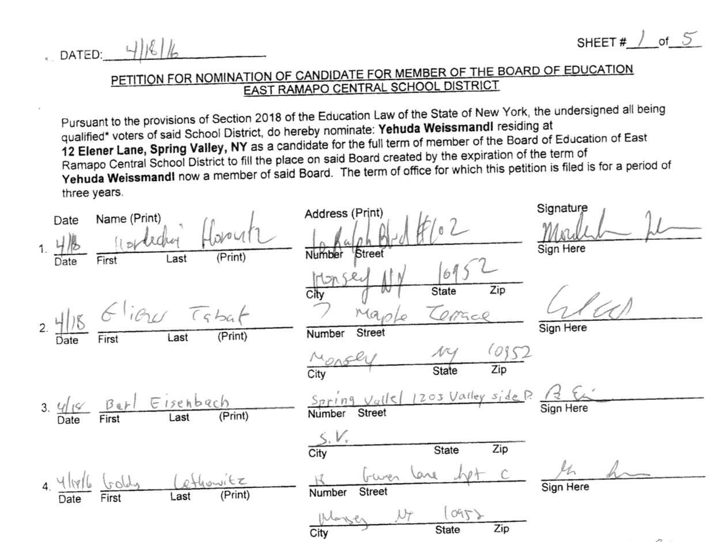
New ways to detect patterns of racial preference
Barreto and Collingwood ǁ AAAS Conference ǁ Seattle, WA ǁ February 2020

Slide 20
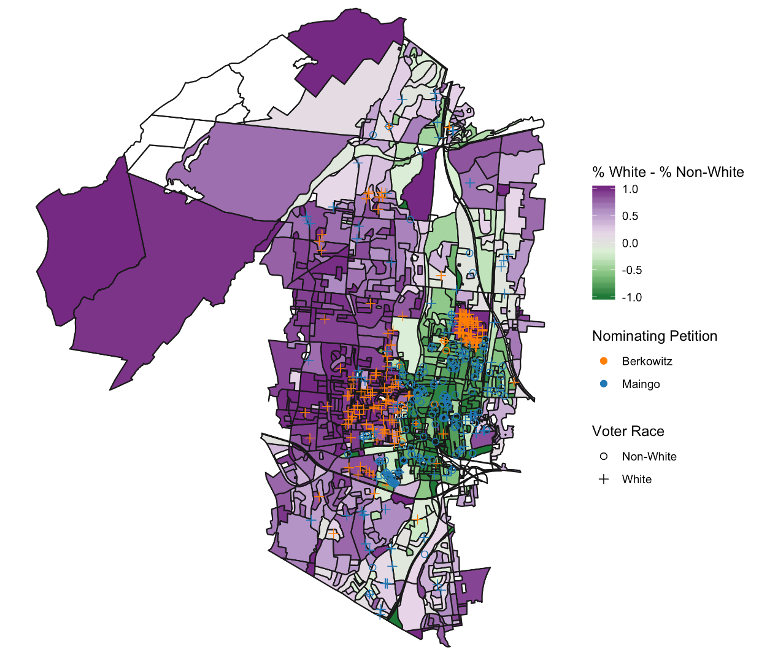
Nominating petitions
We plot nominating petitions by address and race to identify patterns of support for candidates in getting on the ballot in the first place
Barreto and Collingwood ǁ AAAS Conference ǁ Seattle, WA ǁ February 2020

Slide 21
Nominating petitions
We then correlate the race of people who sign nominating petitions with the estimated racial voting patterns
Correlate at 0.93
Barreto and Collingwood ǁ AAAS Conference ǁ Seattle, WA ǁ February 2020

Slide 22
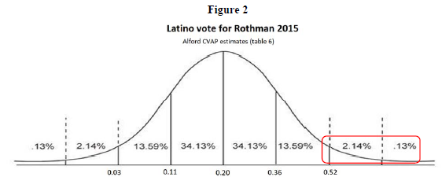
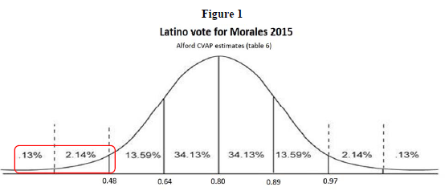
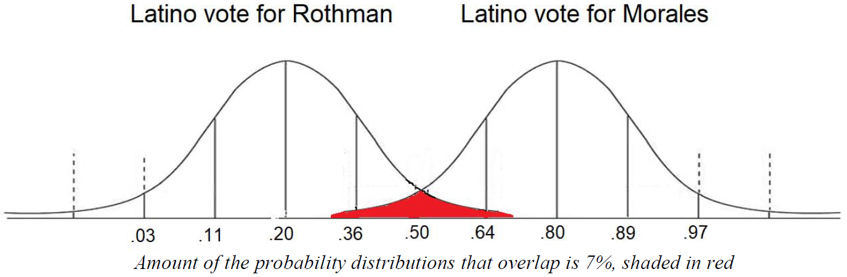
Better understanding of confidence intervals
Only 3.5% chance Morales not Latino preferred
Barreto and Collingwood ǁ AAAS Conference ǁ Seattle, WA ǁ February 2020

Slide 23
Better understanding of confidence intervals
Barreto and Collingwood ǁ AAAS Conference ǁ Seattle, WA ǁ February 2020

